Slide 1
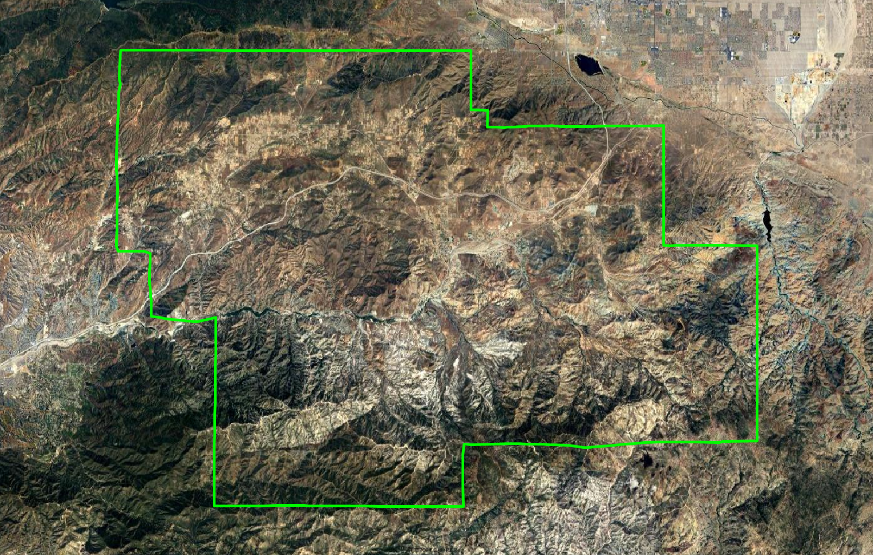
Acton-Agua Dulce Unified School District Introduction to Districting
Dr. Justin Levitt, Vice-President
National Demographics Corporation

Slide 2
Election Systems
“At Large”
“From District” or “Residence” Districts
“By District”
The California Voting Rights Act was written to specifically encourage by-district elections.

Slide 3
California Voting Rights Act (CVRA)
Under the Federal Voting Rights Act (passed in 1965), a jurisdiction must fail 4 factual tests before it is in violation of the law.
The California VRA makes it significantly easier for plaintiffs to force jurisdictions into “by-district” election systems by eliminating two of the US Supreme Court Gingles tests:
Can the protected class constitute the majority of a district?
Does the protected class vote as a bloc?
Do the voters who are not in the protected class vote in a bloc to defeat the preferred candidates of the protected class?
Do the “totality of circumstances” indicate race is a factor in elections?
Liability is now determined only by the presence of racially polarized voting and dilution of the protected class’s voting strength

Slide 4
CVRA Impact
Switched (or in the process of switching) as a result of CVRA:
At least 240 school districts
34 Community College Districts
160+ cities
1 County Board of Supervisors
Over 50 special districts.
Cases So Far:
Palmdale, Santa Clara and Santa Monica went to trial on the merits. Palmdale and Santa Clara lost. Santa Monica is awaiting a decision.
Modesto and Palmdale each spent about $1.8 million on their defense (in addition to the attorney fee awards in those cases).
Santa Monica has spent an estimated $7 million so far. Plaintiffs in Santa Monica requested $22 million in legal fees after the original trial.
Sample settlements:
Palmdale: $4.7 million
Modesto: $3 million
Highland: $1.3 million
Anaheim: $1.1 million
Whittier: $1 million
Santa Barbara: $600,000
Tulare Hospital: $500,000
Camarillo: $233,000
Compton Unified: $200,000
Madera Unified: about $170,000
Hanford Joint Union Schools: $118,000
Merced City: $42,000
An estimated $16 million in total settlements and court awards so far.

Slide 5
Districting Process
Step | Description
Two Initial Hearings October 10 & 24, 2024 | Held prior to release of draft maps. Education and to solicit input on the composition of districts.
Two community forums October 15 & November 20 | Two community meetings to educate and inform the community about the districting process and receive input
Release draft maps November 7, 2024 | Maps must be posted at least 7 days prior to 3rd hearing.
Two hearings on draft maps November 14 & December 19 | Two meetings to discuss and revise the draft maps and to discuss the election sequence.
Map adoption December 19, 2024 | Map adopted via resolution. Final map must be posted at least 7 days prior to adoption.
County Committee Hearing Early 2025 | The Los Angeles County Committee on School District Organization must hold a hearing within the district for final approval of the change to by-Trustee Area elections

Slide 6
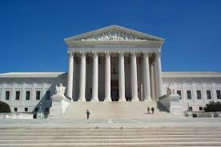
Districting Rules and Goals
1. Federal Laws
2. California Criteria
2. California Prohibition
Equal Population
Federal Voting Rights Act
No Racial Gerrymandering
In prioritized order:
Geographically contiguous
Avoid division of neighborhoods and “communities of interest” (Socio-economic geographic areas that should be kept together)
Avoid division of Cities and Census Designated Places
Easily identifiable boundaries
Compact (Do not bypass one group of people to get to a more distant group of people)
“Shall not adopt election district boundaries for the purpose of favoring or discriminating against an incumbent, political candidate, or political party.”
3. Other Traditional Redistricting Principles
Future population growth

Slide 7
Key Demographics
“Citizen Voting Age Population” data from the Census Bureau’s American Community Survey is considered the best available data on “eligible voters.”

Slide 8
Demographic Summary
Each of five Trustee Areas would contain about 2,453 people.

Slide 9
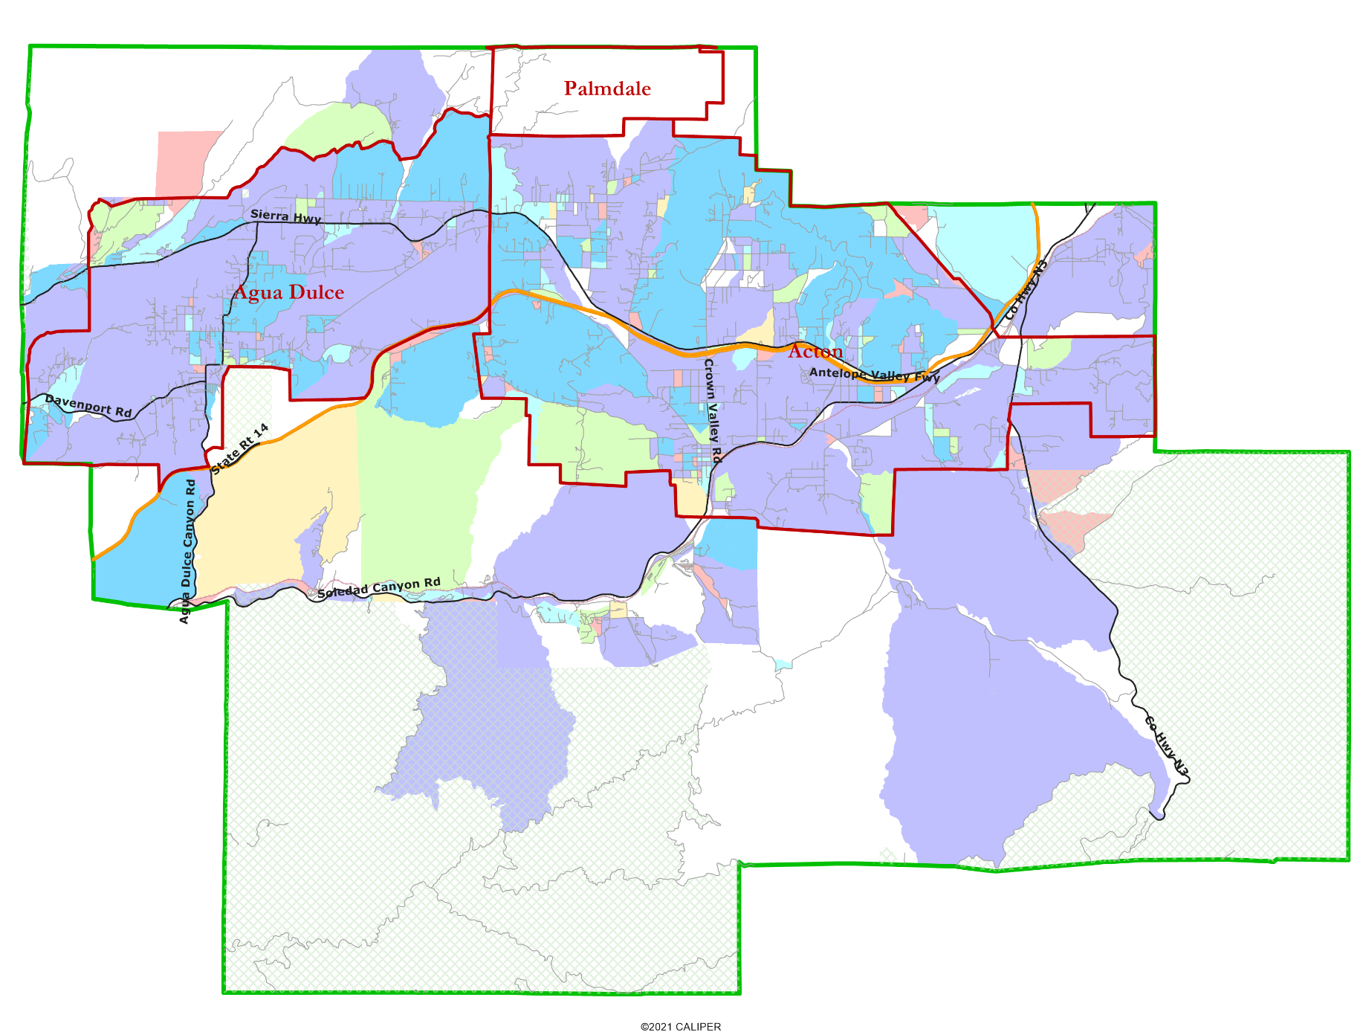
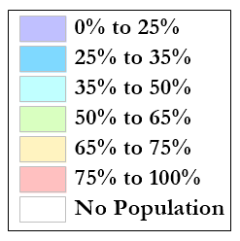
Latino CVAP
No specific concentration of Latino residents; the small pink Census Blocks each contain a small population.
No concentrations of Asian-Americans, African-Americans or Native Americans

Slide 10
Defining Neighborhoods
1st Question: How do you describe or name the area where you live?
2nd Question: What are its geographic boundaries?
What other neighborhoods are there?
Examples of physical features defining a neighborhood boundary:
Natural neighborhood dividing lines, such as highway or major roads, rivers, canals and/or hills
Areas around parks or schools
Other neighborhood landmarks

Slide 11
Defining Communities of Interest
California Elections Code Section 21130(c)(2):
A “community of interest” is a population that shares common social or economic interests that should be included within a single district for purposes of its effective and fair representation.
The shared interests may include (but are not limited to):
Shared public policy concerns such as education, public safety, public health, environment, housing, transportation, and access to social services. cultural districts;
Shared socioeconomic characteristics;
Similar voter registration rates and participation rates; and /or
Shared histories.
Definitions of Communities of Interest may not include relationships with political parties, incumbents, or political candidates.

Slide 12
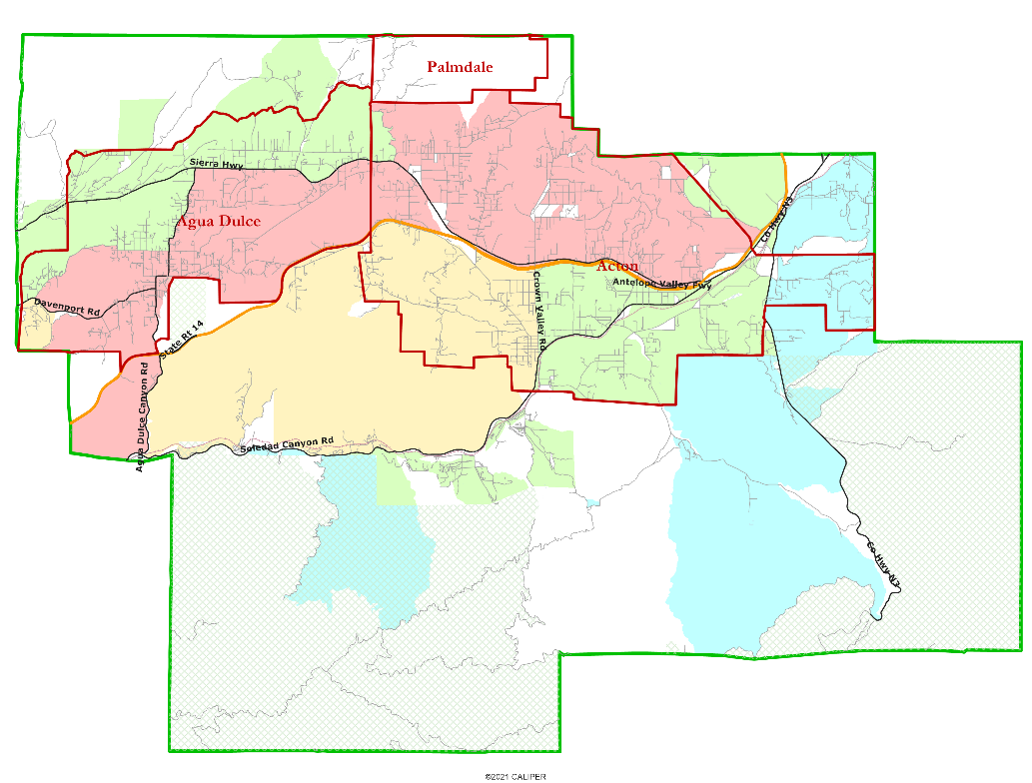
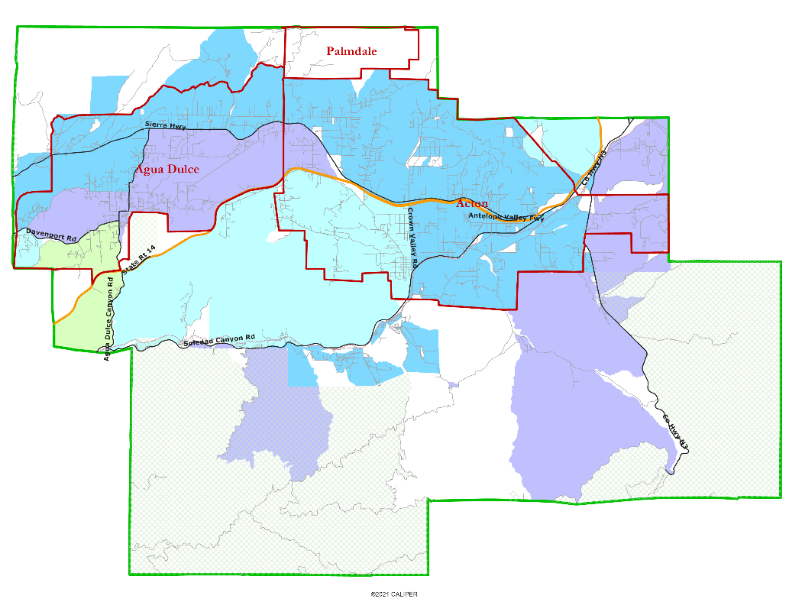
Other Socio-Economic Demographics
Percent of families with child at home
Percent of households earning more than $75k

Slide 13
Your Turn:
What area do you consider your neighborhood?
What are your “communities of interest”?
For each answer, please provide:
Geographic boundaries
The history or defining shared characteristic of the area
In the absence of public testimony, planning records and other similar documents may provide definition.
Any other questions about the process, criteria, maps, or any other part of this process?

Slide 14
Share Your Thoughts
Website
https://www.aadusd.k12.ca.us/

